Slide 1
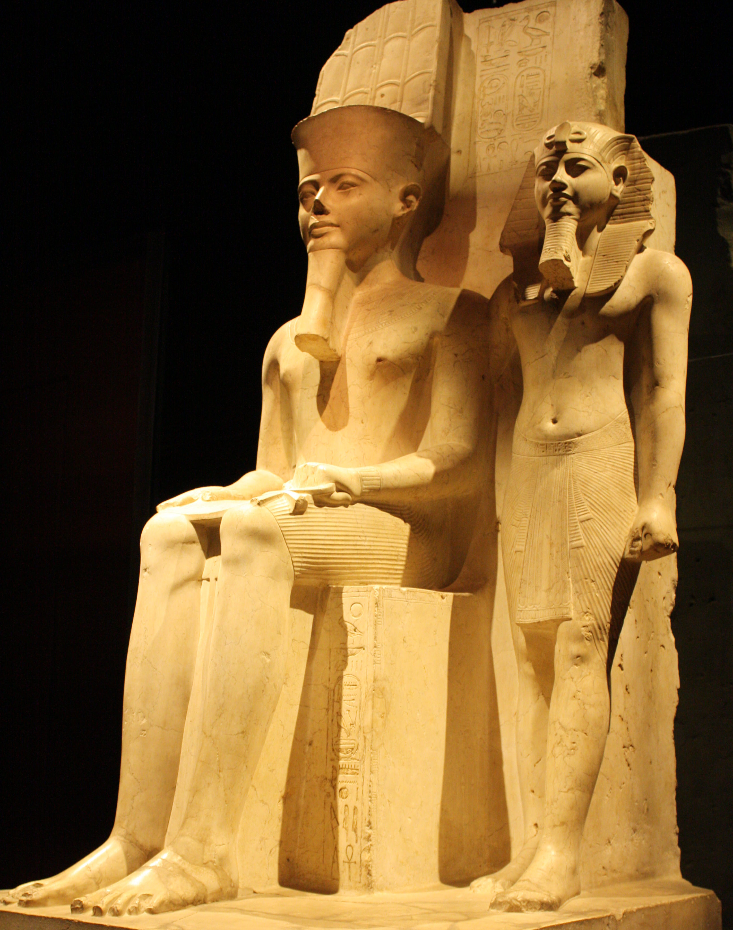
Old, Middle, and New
GOAL/S: Describe old, middle, and new kingdom Egypt
Week 8, Lesson 3

Slide 2
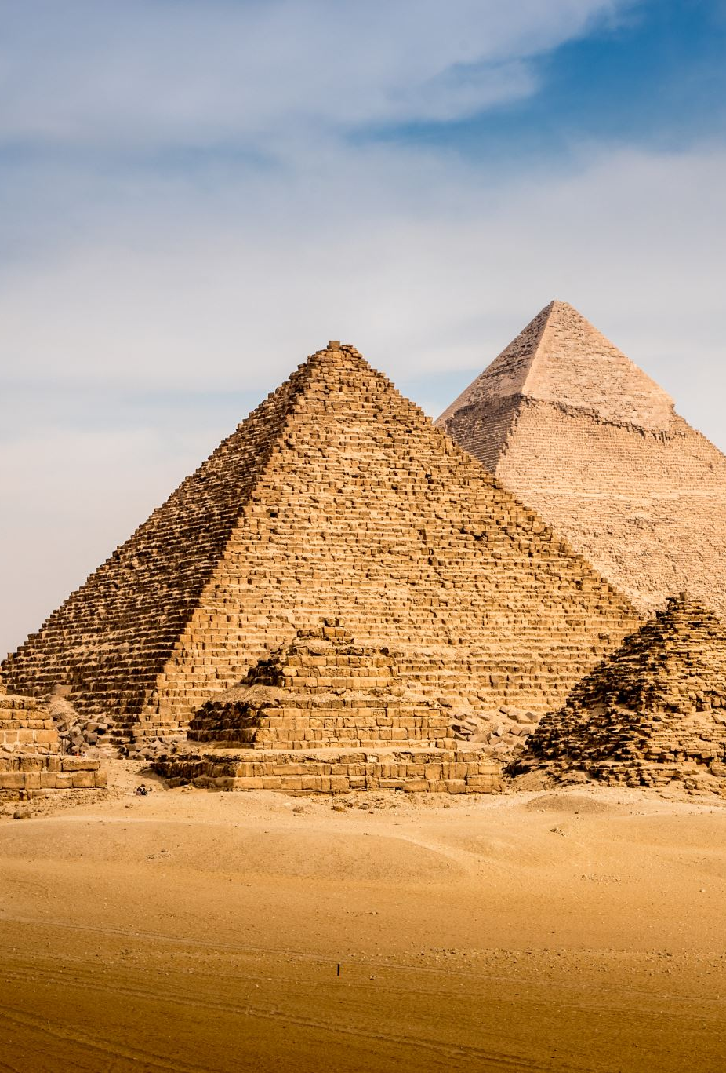
What is a ‘kingdom’?
DEFINE
‘Kingdom’ refers to periods when particular ‘dynasties’ had strong control over most of Egypt.
We have several primary sources for the list of pharaohs, but they all disagree slightly with each other.

Slide 3

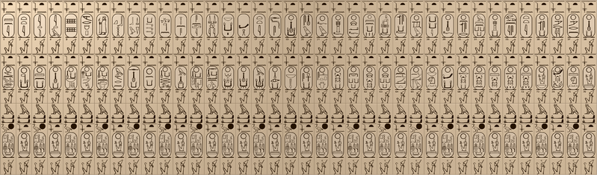
Abydos King List
The Abydos King List, also known as the Abydos Table, is a list of the names of 76 kings of ancient Egypt, found on a wall of the Temple of Seti I at Abydos, Egypt. It consists of three rows of 38 cartouches (borders enclosing the name of a king) in each row.

Slide 4
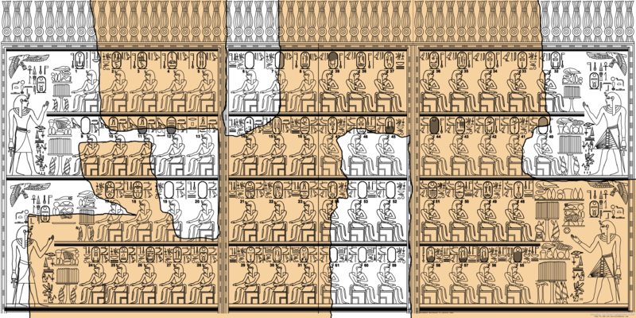
Karnak King List
The Karnak King List, a list of early Egyptian kings engraved in stone, was located in the Karnak Temple Complex, in modern Luxor, Egypt. It listed sixty-one kings from Egypt's Old Kingdom. Only the names of thirty-nine kings are still legible, and one is not written in a cartouche (a border used normally to surround the name of a king).

Slide 5

Today’s Lesson
Summarising the 3 ‘Kingdoms’ – Old Kingdom, Middle Kingdom, and New Kingdom

Slide 6
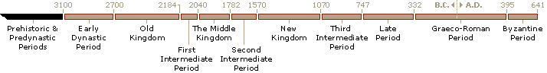
Egyptian Chronology

Slide 7
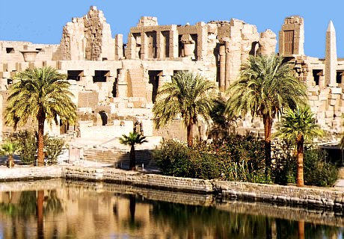
The Old Kingdom (c. 2686–2181 BCE)
SUMMARISE
3rd – 6th dynasties
Pyramid Age
Long period of peace, order and economic prosperity
Rise of some religious cults

Slide 8
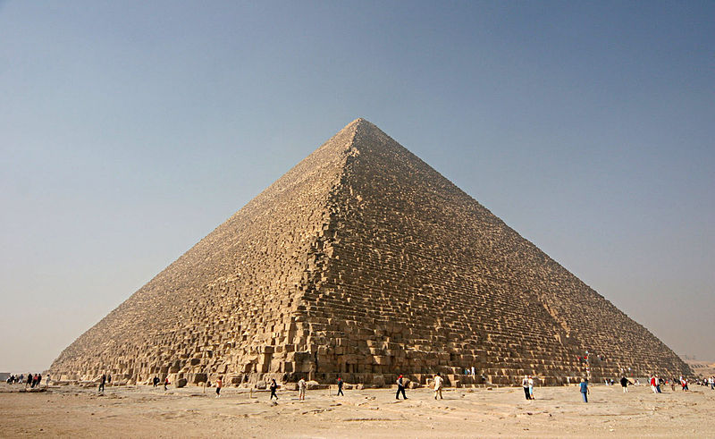
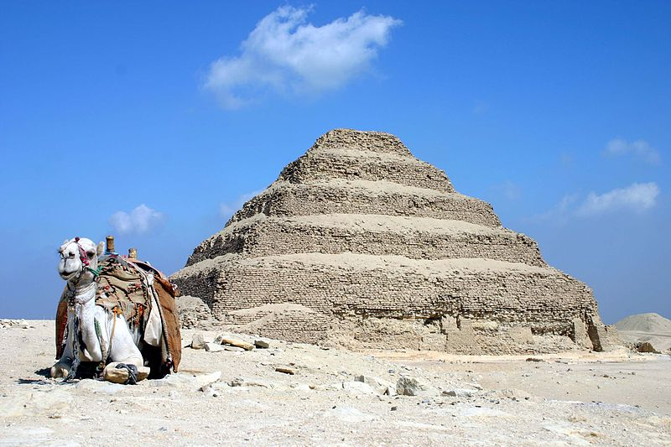
3rd dynasty’s Djoser asked Imhotep, an architect, to design a tomb for him - created the world’s first major stone building, Step-Pyramid at Saqqara Great Pyramid at Giza built for Khufu (Cheops), who ruled from 2589 - 2566 B.C. Great Pyramid is 150m high, contains 2,300,000 granite blocks, each weighs 2.5 tonnes

Slide 9
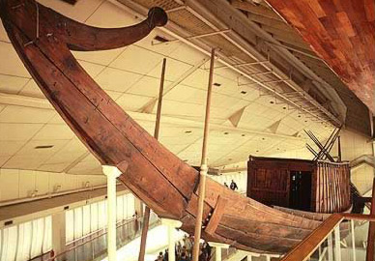
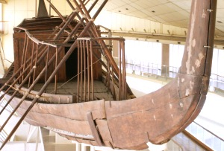
In the Great Pyramid was a 43-metre-long boat, built to carry Khufu to the afterlife

Slide 10
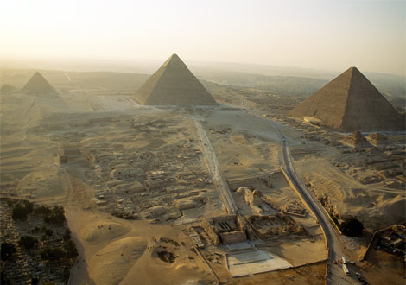
The other two pyramids were built for:
Khafra
(2558-2532 B.C)
Menkaura
(2532-2503 B.C.)

Slide 11
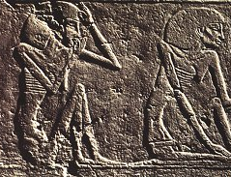
Decline of the Old Kingdom
SUMMARISE
Pyramids building and declining international trade meant the pharaoh had less money.
A series of dry decades led to low floods, poor harvests and famine.
Pharaoh’s political and religious power was questioned.

Slide 12
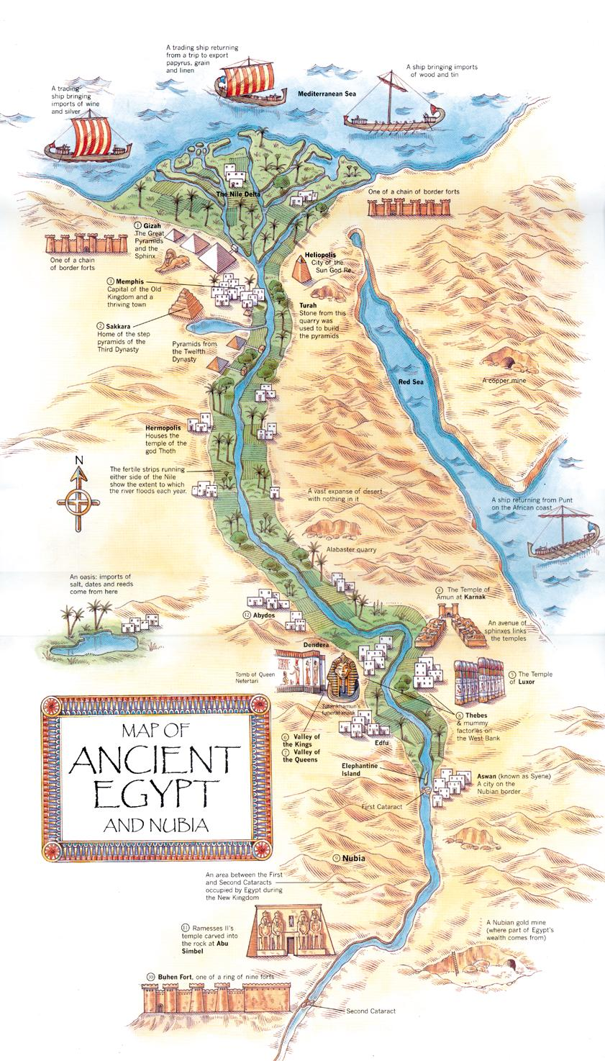
First Intermediate Period (c. 2181–2040 BCE)
SUMMARISE
Intermediate period is when:
Pharaoh loses control over Egypt
Nobles take control of parts of the country and fought against each other
Foreigners from Asia to moved into the Nile Delta.

Slide 13
Egyptian Chronology

Slide 14
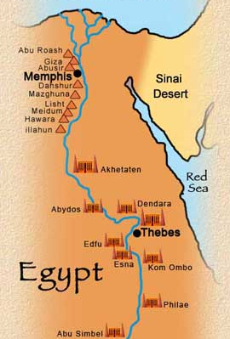
The Middle Kingdom (c. 2055–1786 BCE)
SUMMARISE
Central power restored after First Intermediate Period
11th and 12th dynasties
Also known as the ‘Restoration Period’
Capital moved to It-towy, south of Memphis

Slide 15
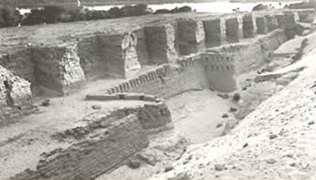
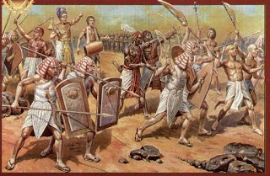
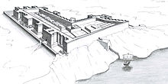
Contact and War
SUMMARISE
Traded with Lebanon, Syria and Palestine to the north
Most important trading partner was Nubia to the south
Traded beer, wine, linen, cheese, oil and tools for Nubian gold, copper, precious stones, ebony, ivory and exotic animals.
Nubia was a key source of slaves
Aggressive foreign policy
Repelling the Bedouins
Often at war with and conquered Nubia
Built forts to control the routes to the Nubian gold mines.
Notes:
Bedouin - Arabic-speaking nomadic peoples of the Middle Eastern deserts, especially of North Africa, the Arabian Peninsula, Egypt, Israel, Iraq, Syria, and Jordan.

Slide 16
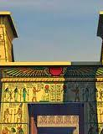
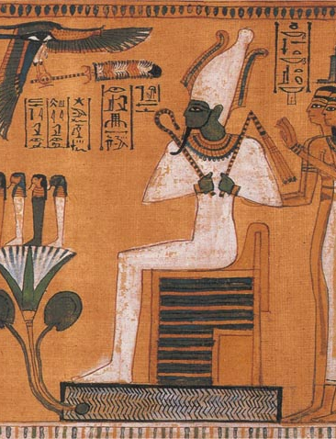
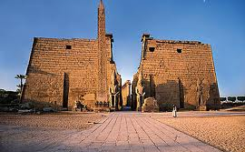
Religion
SUMMARISE
Osiris becomes more important than Horus
Huge temples and sculptures built.
Thebes remained a great religious centre
Amun was a local deity of Thebes

Slide 17
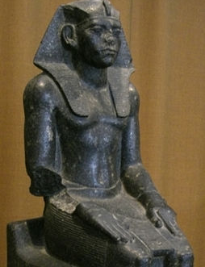
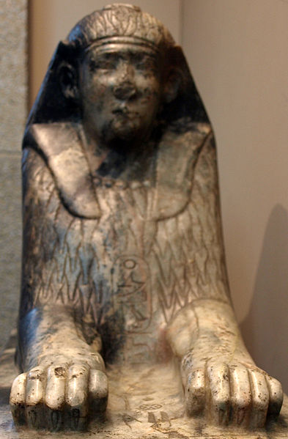
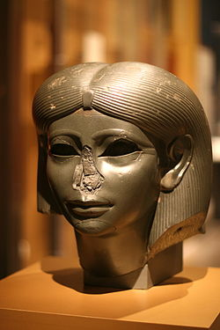
Reached its peak under Amenemhet III (1842-1797 B.C.)
Decline began under Amenenhet IV (1798-1790 B.C.)
His sister, Sobekneferu (1789-1786 B.C.) was first female ruler of Egypt and the last ruler of the 12th dynasty

Slide 18
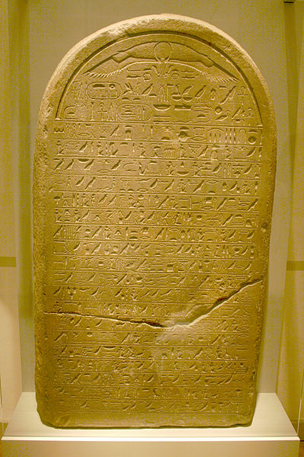
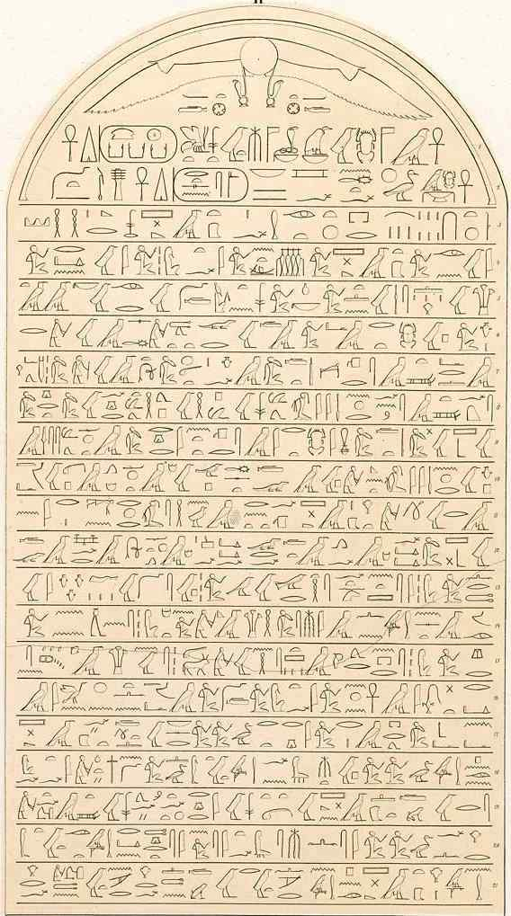
Pharaoh as a conqueror
SUMMARISE
Pharaohs began using military success as evidence of their divinity
Successful expansion was required in order to be a good pharaoh
Pharaohs tried to make their successes as obvious as possible

Slide 19
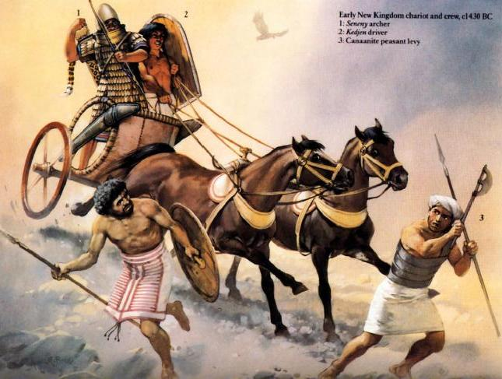
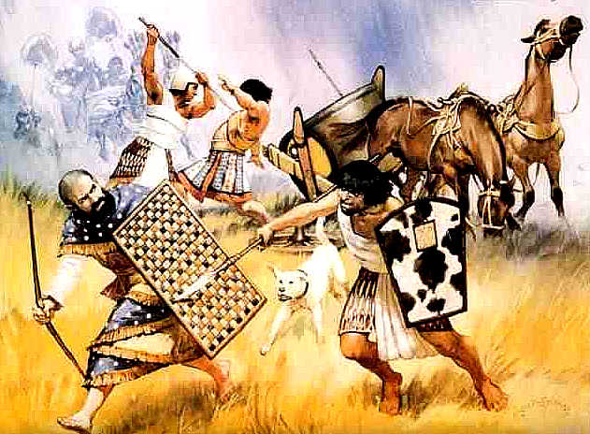
The Second Intermediate Period (c. 1786–1570 BCE)
SUMMARISE
Egypt divided into several spheres of influence
Two capitals: Thebes and Xois (in the Nile delta)
c. 1650 BCE, Hyksos invaded and introduced horse-drawn chariots, conquering Xois
Theban rulers paid taxes to the Hyksos
Thebans launched war against the Hyksos around 1570 B.C., driving them out of Egypt.

Slide 20
Egyptian Chronology

Slide 21
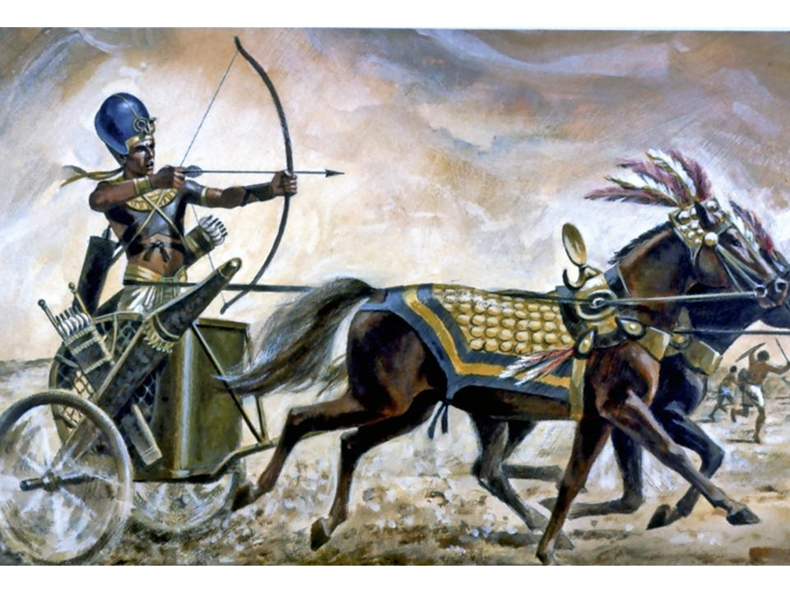
The New Kingdom (c. 1570–1070 BCE)
SUMMARISE
18th - 20th dynasties
Hyksos were driven out by Ahmose, first king of 18th dynasty
Egypt conquers other lands
Peak of Egypt’s power

Slide 22
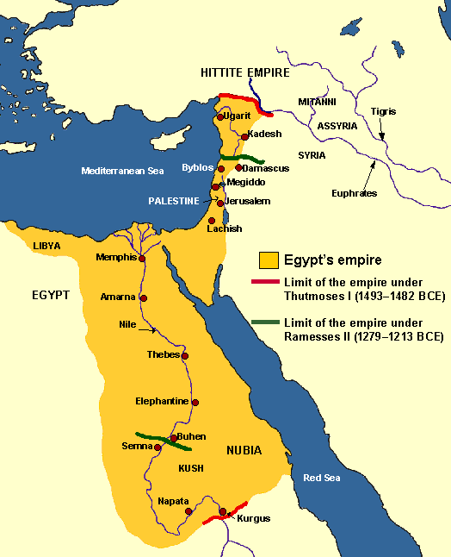
Wars of the New Kingdom
Military campaigns in Palestine and Nubia
Tuthmose III defeated 300+ Asiatic princes at the Battle of Megiddo
Seti I and Rameses II fought against Hittites
Massive tribute paid by conquered rulers in treasure, slaves and livestock
Great empire, stretching from Nubia to the Euphrates River in Asia

Slide 23
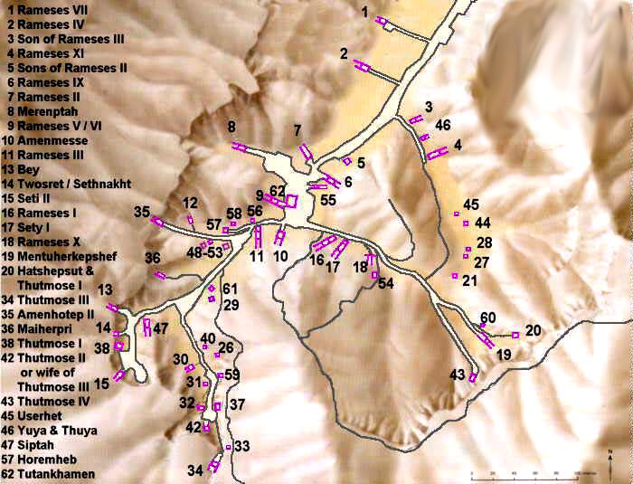
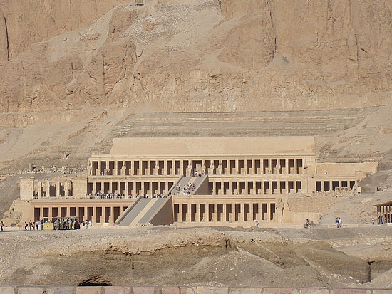
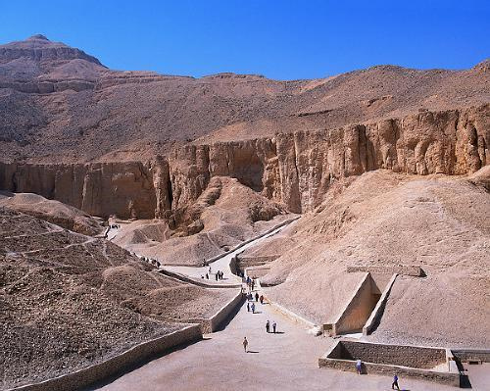
Ramses I and II period restoration of the weakened Egyptian empire and an impressive amount of building
According to biblical chronology, the exodus of Moses occurred during the reign of Ramses II (1304-1237 B.C.)
Pharaohs buried in tombs (not pyramids) in the Valley of the Kings opposite Thebes

Slide 24
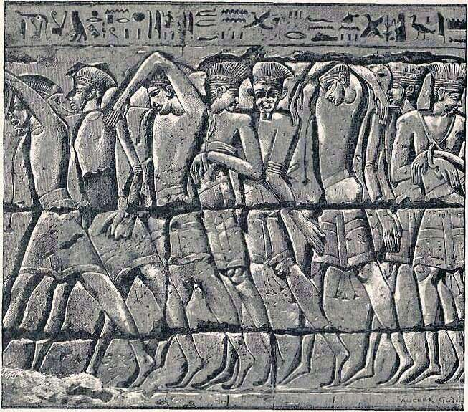
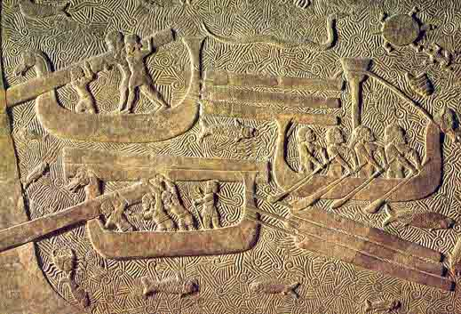
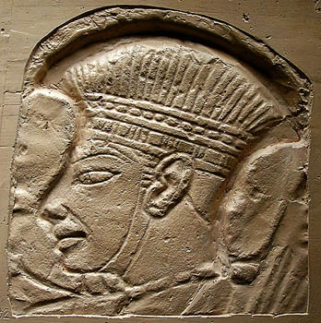
Egypt loses its power
SUMMARISE
The kings who followed Ramses III were less successful
Lost Palestine and Syria
Nile Delta invaded by ‘Sea Peoples’

Slide 25
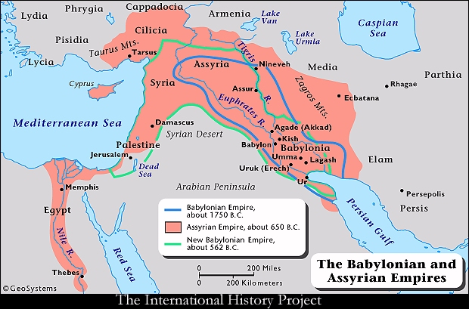
Third Intermediate Period (c. 1085-664 BCE)
SUMMARISE
Local rulers were virtually autonomous during this period
Foreigners from Libya and Nubia invaded
8th century B.C., pharaohs clashed with Assyrian empire
In 671 B.C., the Assyria conquered Memphis and destroyed the city

